Slide 1
SQL Project
Reaghan Briggs

Slide 2
Why are Entity Relationship Diagrams so important for SQL projects?
The image to the right is an example of an Entity Relationship Diagram, and the diagram that I will be using throughout this project.
This diagram shows relationships, for example the crows feet that connecting the film and inventory tables through film_id.
Entity Relationships are an excellent way to also map out how your quires are going to be able to connect without later having issues of not remembering what goes where and how it will all come together.

Slide 3
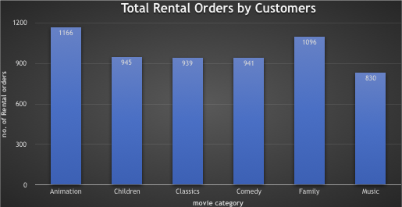
What can we Use sql for?
In this example we will be using SQL to better understand the movies that families are watching.
Family movies are considered anything in the genre of Animation, Children, Classics, Comedy, Family and Music
The graph shown to the right is the results for the numbers of movies for each genre that families watch. This was a query that was performed in SQL

Slide 4
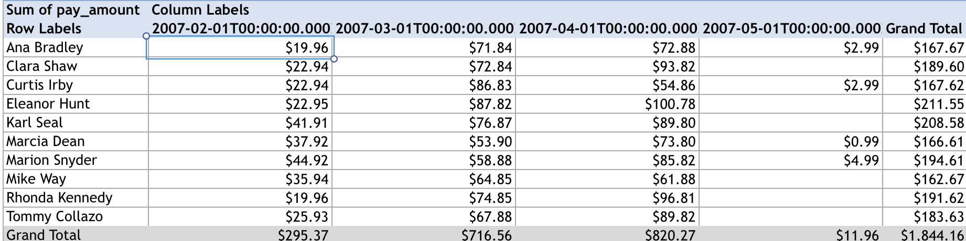
What else can it do?
A simple computer program can show numbers, what makes SQL so different anyways?
A SQL program can show data from the top 10 customers, how many payments they have made in a given month of a year of the monthly , and the amount of the monthly payments and organize it to a level that is much better than any other type of program

Slide 5
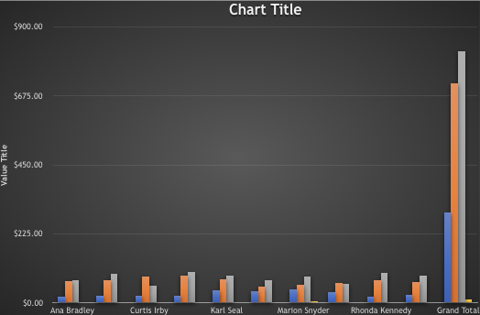
What else can it do? (Cont.)
The following image to the right shows a graph that was created based on the table that was shown in the previous slide.

